Slide 1
Smart Zebra Crossing

Slide 2
Group Members :
Sampreety Pillai
2101CS71
Nishita Lath
2101CS53
Nishtha Taktewale
2101CS89

Slide 3
01
Idea
The main idea of the project

Slide 4
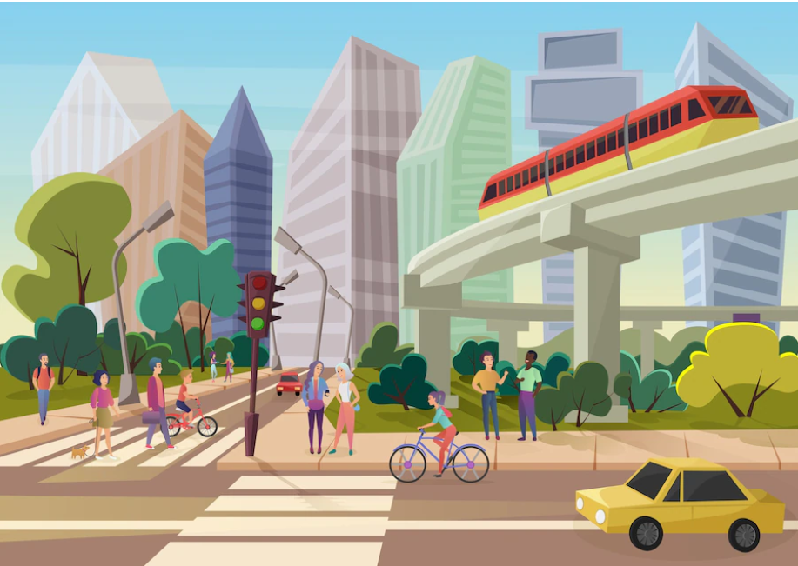
Idea
The Main idea behind our project is to make a mini Zebra-Crossing model which senses the proximity of cars and humans both and opens and closes the gates accordingly.

Slide 5
02
Components
Highlight on the components used to make the model

Slide 6
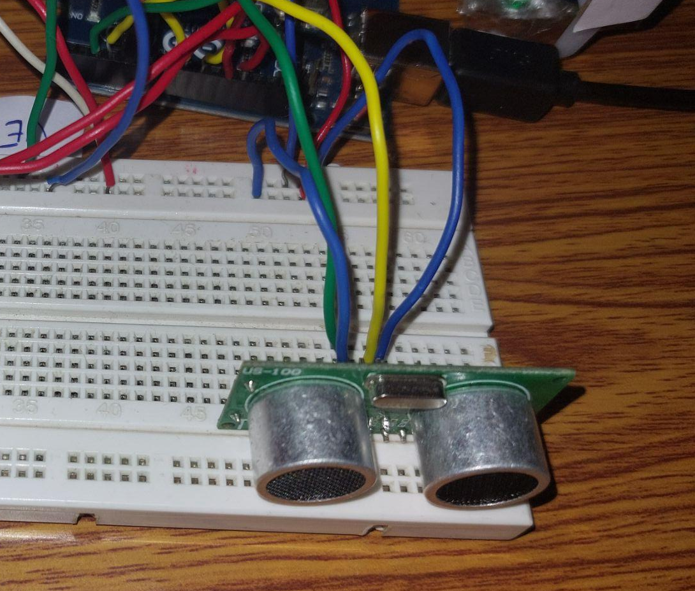
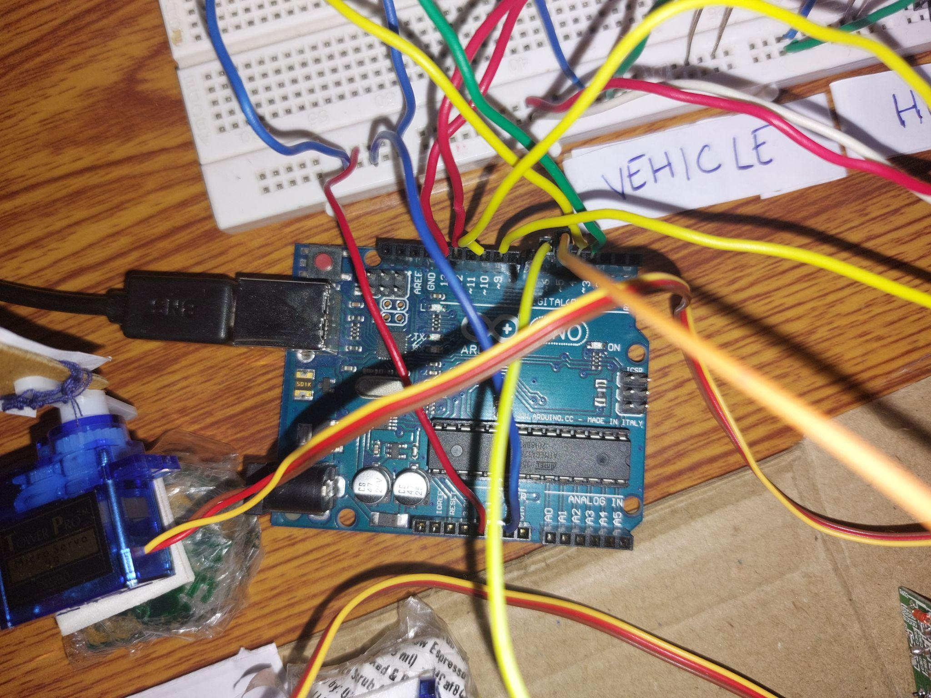
Components
Arduino Uno
Ultrasonic Sensors
An Arduino Uno microcontroller was used to connect the sensors with the software.
2 ultrasonic sensors were used to measure the proximity of cars and humans.

Slide 7
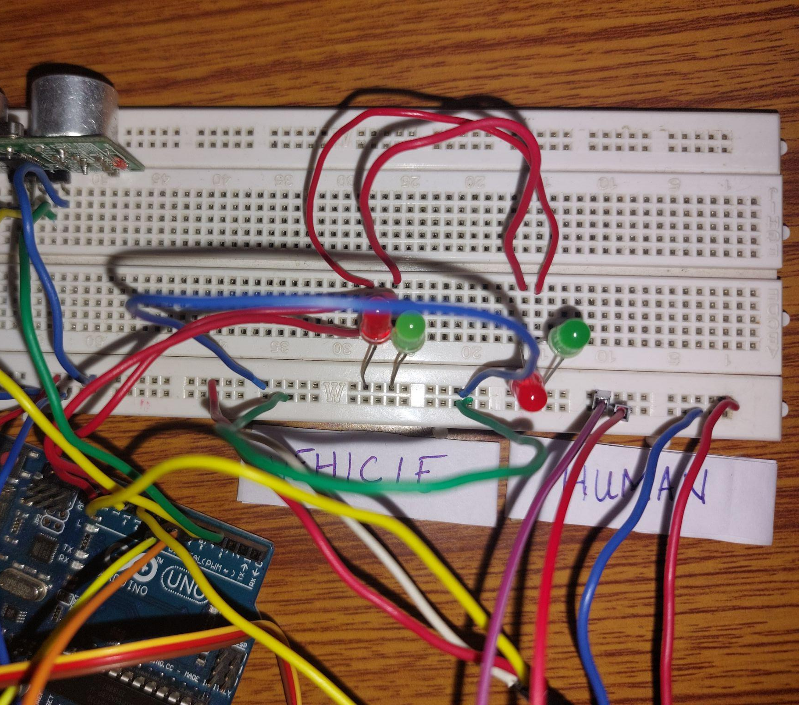
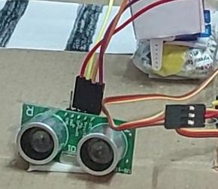
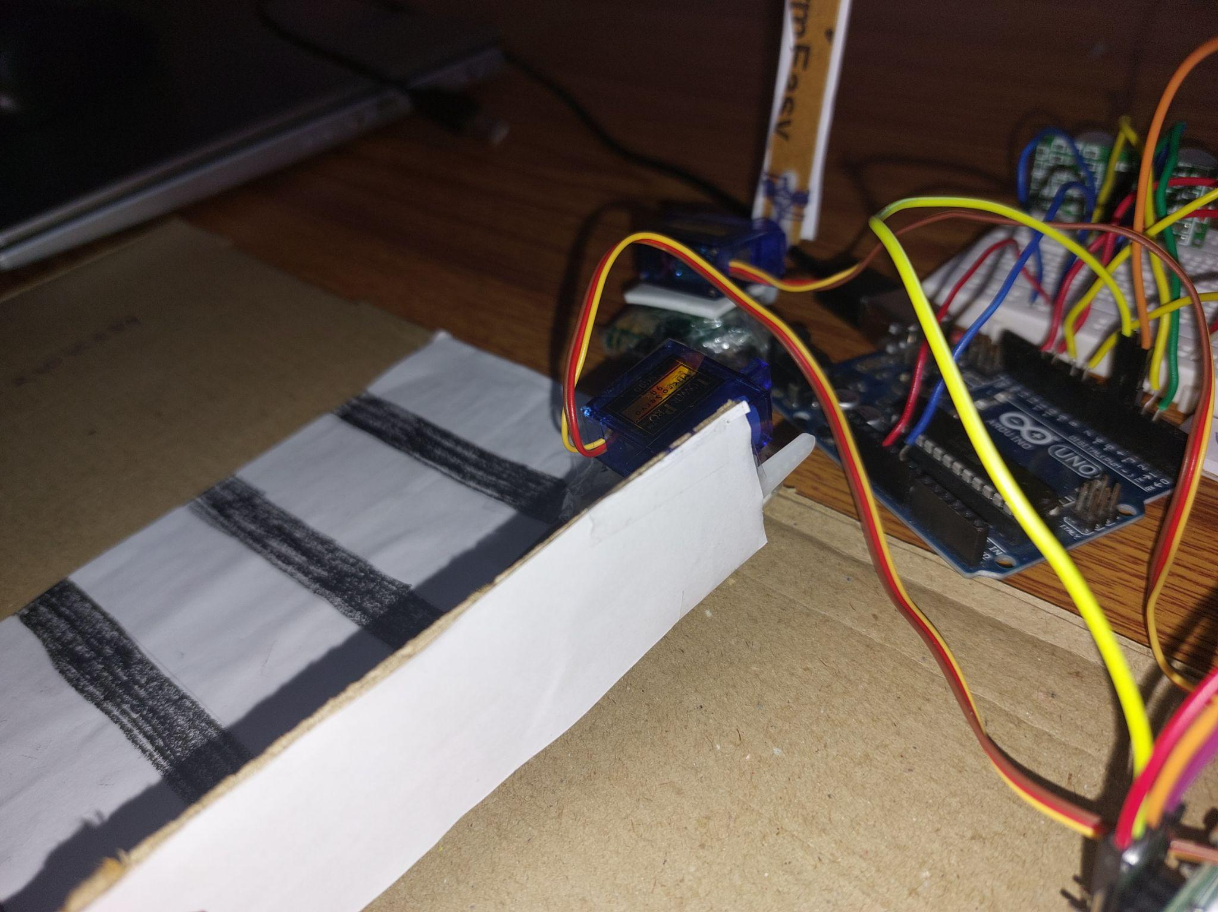
Components
Jumper Wires
LED Lights
We used Male to Female Jumper wires to connect the Ultrasonic Sensor.
2 green LEDs and 2 Red LEDs were used to signify the traffic lights for vehicles and humans
Servo Motors
To open and close the gates, we used two servo motors.

Slide 8
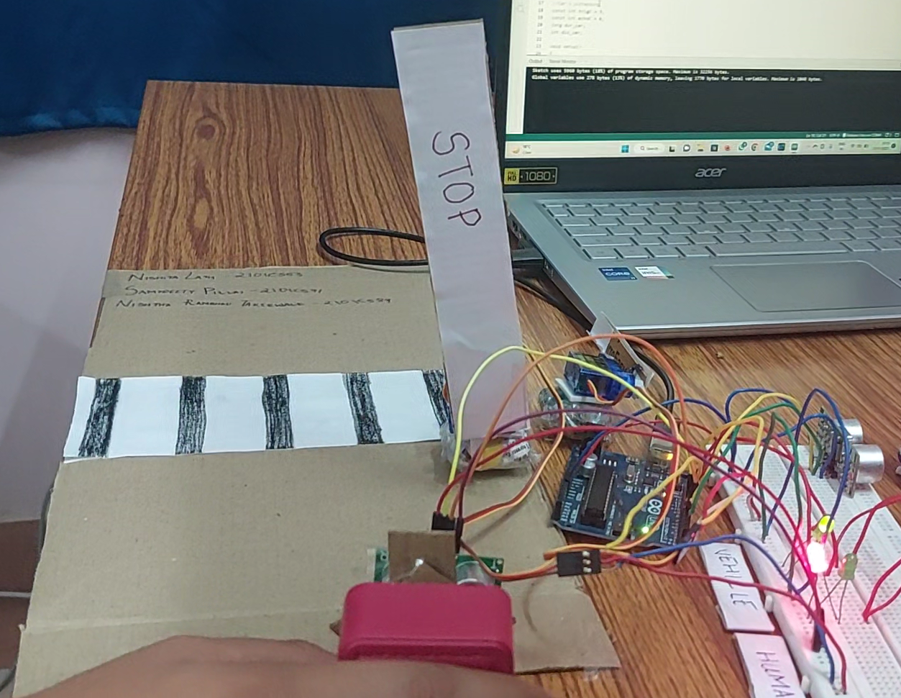
03
The Model
The working of our model

Slide 9
We can consider three cases to show the working of our model.

Slide 10

Case 1 :
When a pedestrian is approaching the Zebra Crossing and there are no cars nearby.
Response : The gate opens for 7 seconds to let the pedestrian pass and the gate for the car closes.

Slide 11
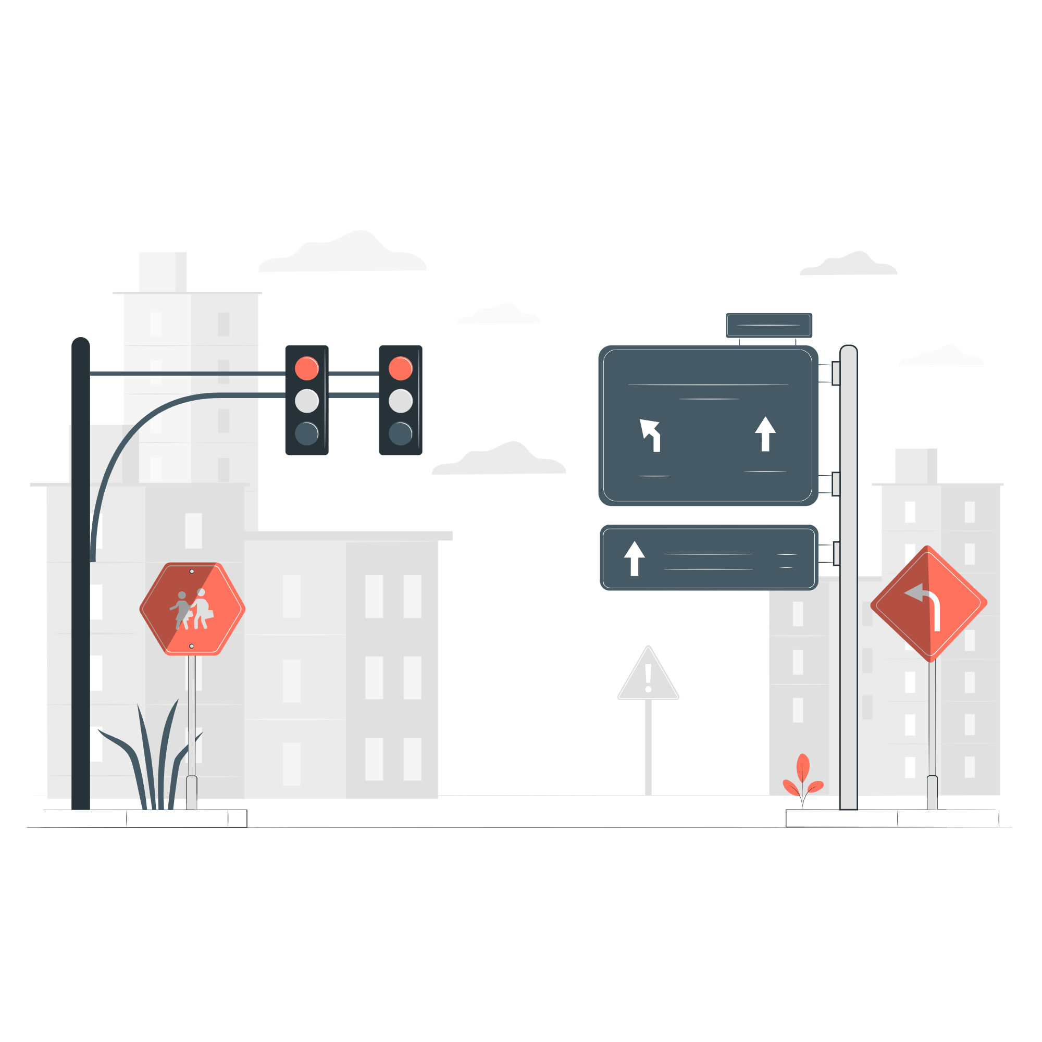
Case 2 :
When a pedestrian is approaching the Zebra Crossing and cars are also in close proximity.
Response : The gate for the pedestrians stays closed for their safety and the model waits till it can’t sense a car nearby to open.

Slide 12
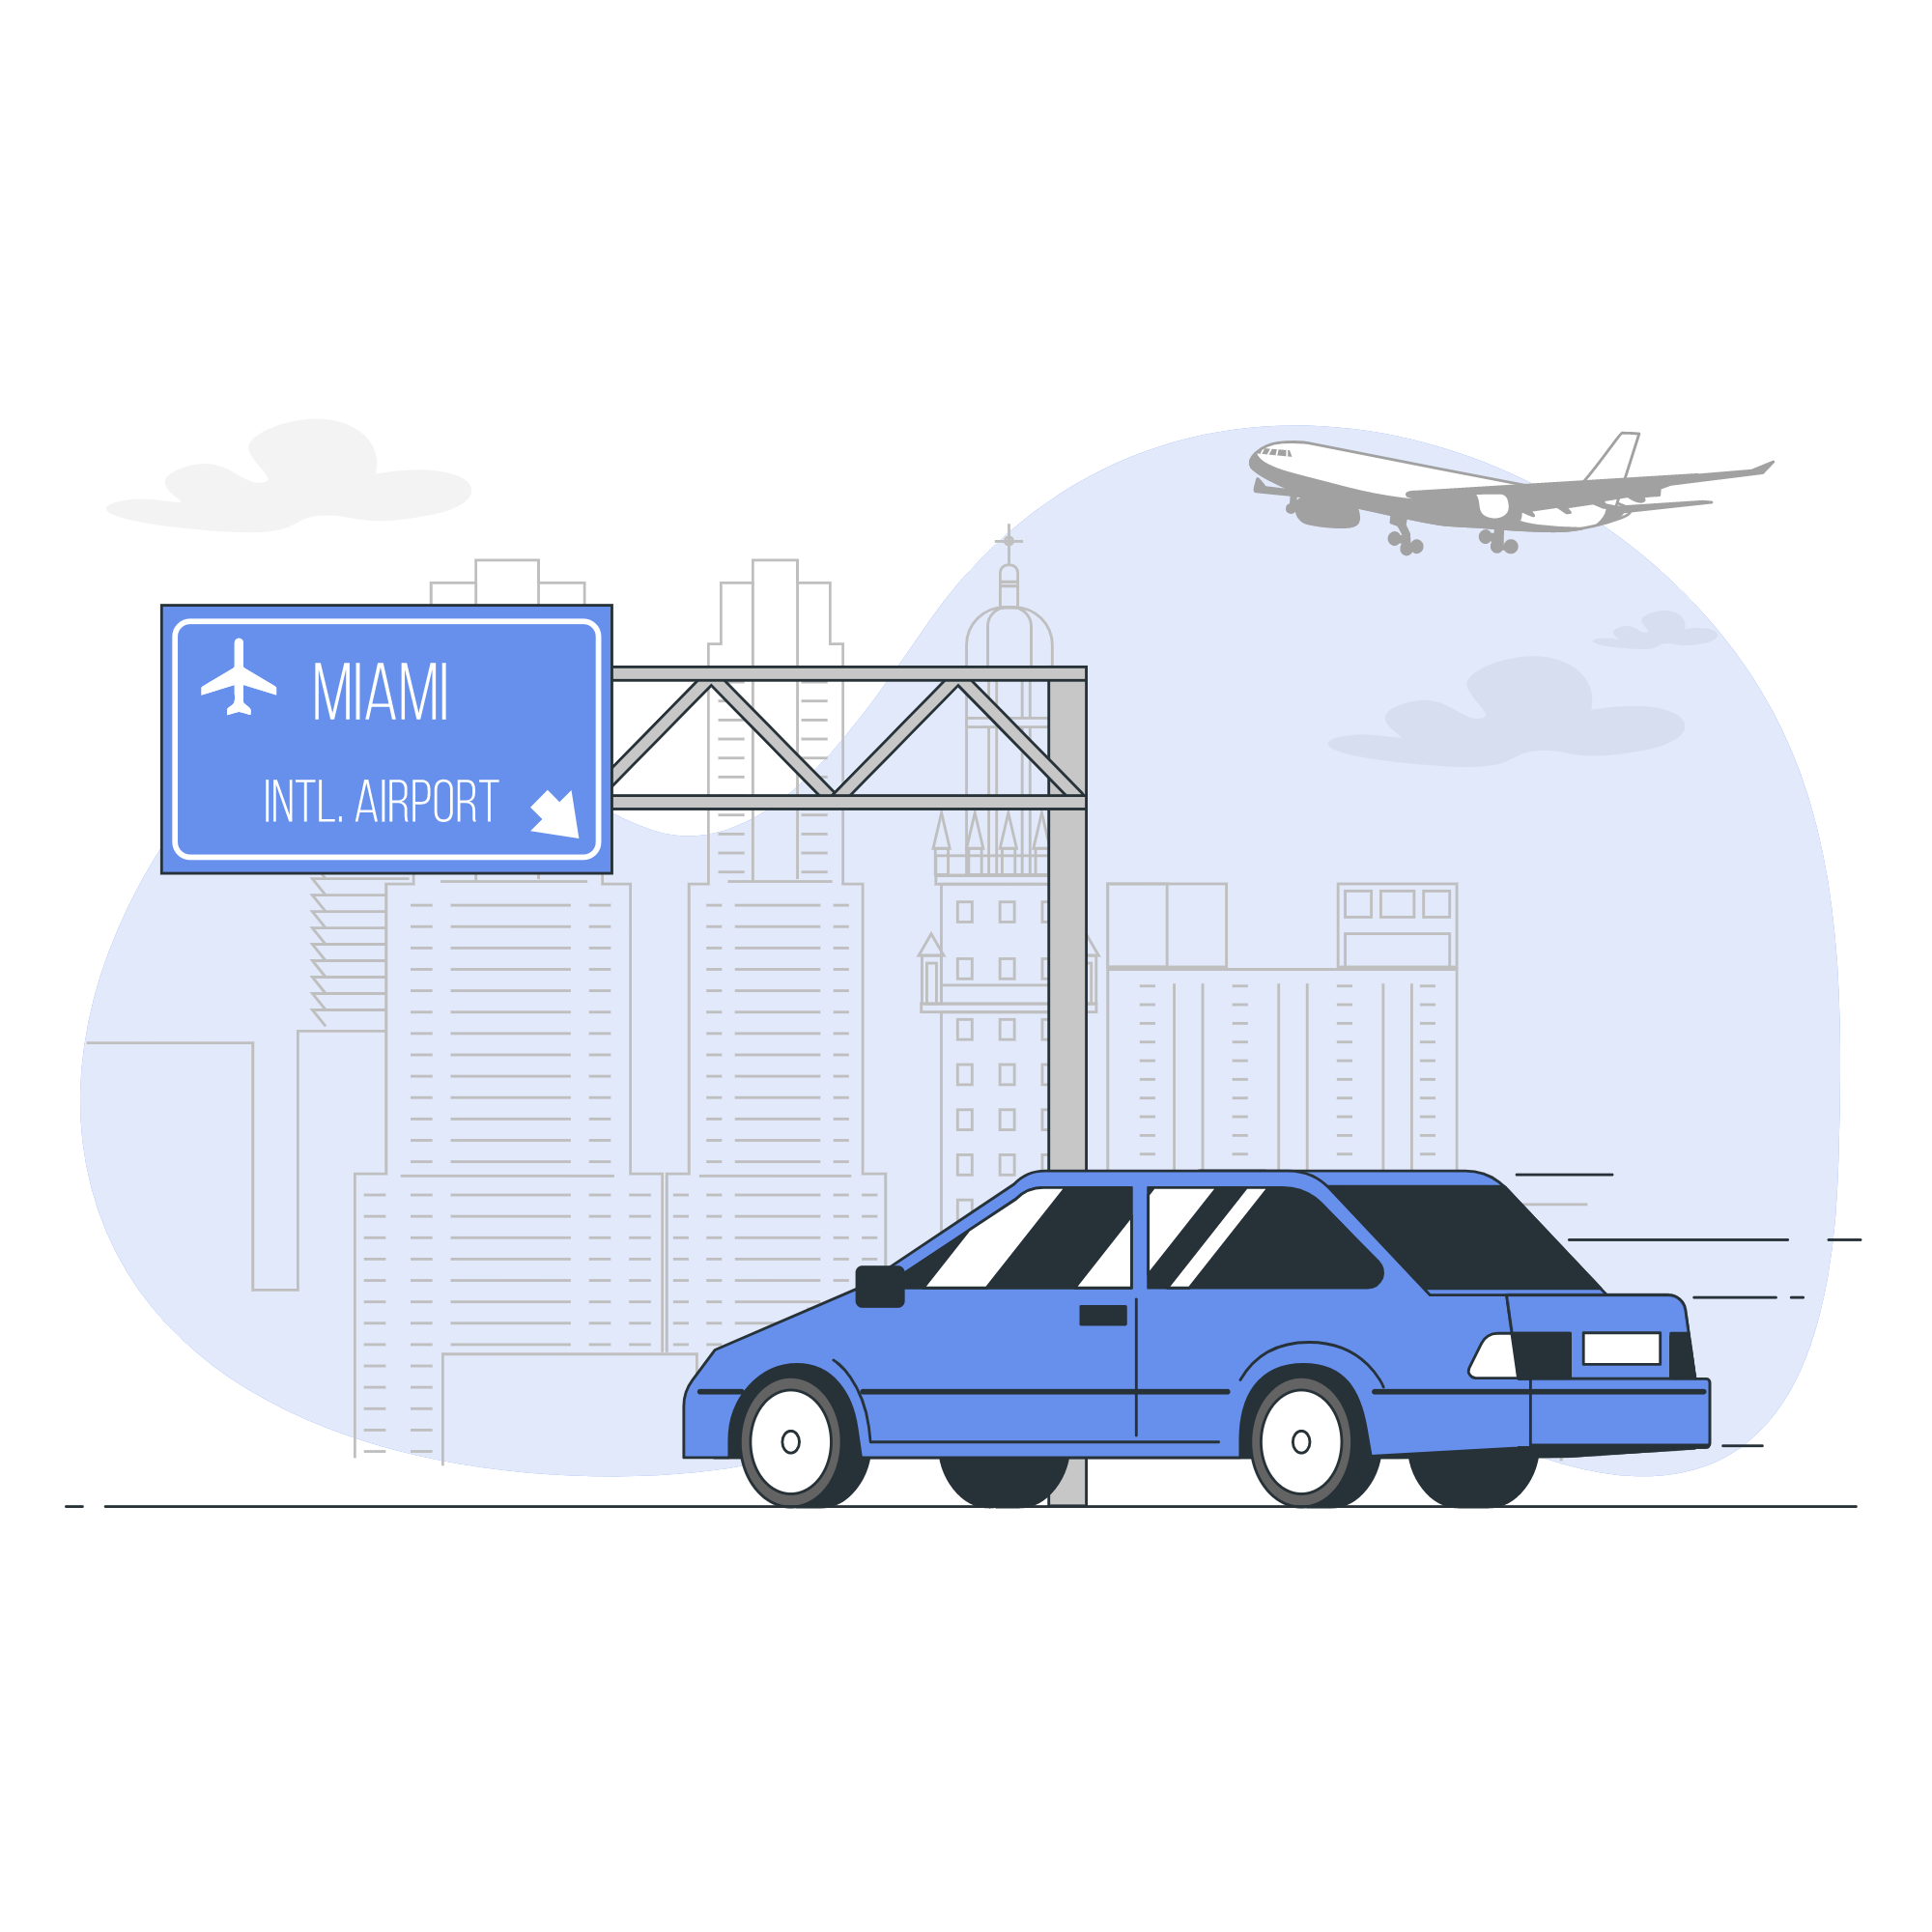
Case 3 :
When a car is approaching and there are no pedestrians nearby
Response : The gate for the car stays open and the gate for the human stays closed.

Slide 13
04
Relevance to Topic
Relevance to the theme of Smart City.

Slide 14
Relevance to Smart City
The project is made as an optimization of a Zebra-Crossing. Which is a daily need in any city. There is a gate which opens and closes keeping in mind the proximity of the nearby traveling cars and respond appropriately. Such an arrangement ensures safety for the people using it since it reduces the number of road accidents by restricting movement when not required. Therefore, with accurate sensing, a convenient model can be adopted that benefits the people using it.

Slide 15
Thank You!

